Slide 1
Cryptography and Network Security
Network Security Model

Slide 2
Session Meta Data
Author | Dr T Sree Sharmila
Reviewer
Version Number | 1.0
Release Date | 25 June 2018

Slide 3
Revision History
Revision Date | Details | Version no.
 |  | 1.0

Slide 4
Agenda
Basic terminology
Model for Network security
Summary
Test your understanding
References

Slide 5
Basic terminology
Plaintext: original message to be encrypted
Ciphertext: the encrypted message
Enciphering or encryption: the process of converting plaintext into ciphertext
Encryption algorithm: performs encryption
Two inputs: a plaintext and a secret key

Slide 6
Basic terminology
Deciphering or decryption: recovering plaintext from ciphertext
Decryption algorithm: performs decryption
Two inputs: ciphertext and secret key
Secret key: same key used for encryption and decryption
Also referred to as a symmetric key

Slide 7
Basic terminology
Cipher or cryptographic system : a scheme for encryption and decryption
Cryptography: science of studying ciphers
Cryptanalysis: science of studying attacks against cryptographic systems
Cryptology: cryptography + cryptanalysis

Slide 8
Agenda
Basic terminology
Model for Network security
Summary
Test your understanding
References

Slide 9
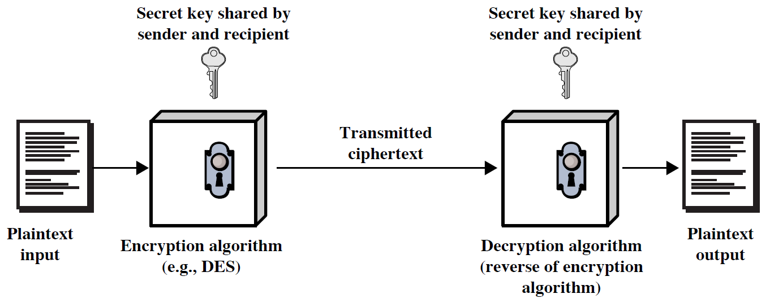
Symmetric Cipher Model

Slide 10
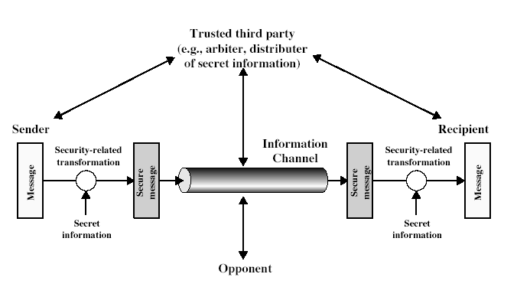
Model for Network Security

Slide 11
Model for Network Security
using this model requires us to:
design a suitable algorithm for the security transformation
generate the secret information (keys) used by the algorithm
develop methods to distribute and share the secret information
specify a protocol enabling the principals to use the transformation and secret information for a security service
Notes:
Key: unique for each pair
protocol: encryption and decryption

Slide 12
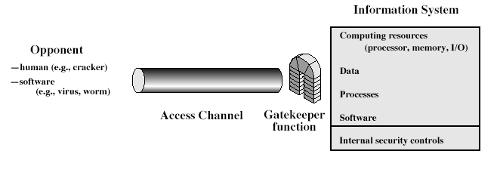
Model for Network Access Security
Notes:
Stallings Fig 1-4.
The second model is concerned with controlled access to information or resources on a computer system, in the presence of possible opponents. Here appropriate controls are needed on the access and within the system, to provide suitable security. Some cryptographic techniques are useful here also.

Slide 13
Model for Network Access Security
using this model requires us to:
select appropriate gatekeeper functions to identify users
implement security controls to ensure only authorised users access designated information or resources
trusted computer systems can be used to implement this model

Slide 14
Agenda
Basic terminology
Model for Network security
Summary
Test your understanding
References

Slide 15
Summary
Define basic terminologies used in cryptography
Discuss models for network (access) security

Slide 16
Agenda
Basic terminology
Model for Network security
Summary
Test your understanding
References

Slide 17
Test your understanding
Discuss the model for network security
Define cryptography.
Define cryptanalysis.
What is deciphering?
What is enciphering?

Slide 18
Agenda
Basic terminology
Model for Network security
Summary
Test your understanding
References

Slide 19
References
1. William Stallings, Cryptography and Network Security, 6th Edition, Pearson Education, March 2013.
2. Charlie Kaufman, Radia Perlman and Mike Speciner, “Network Security”, Prentice Hall of India, 2002.

